Slide 1
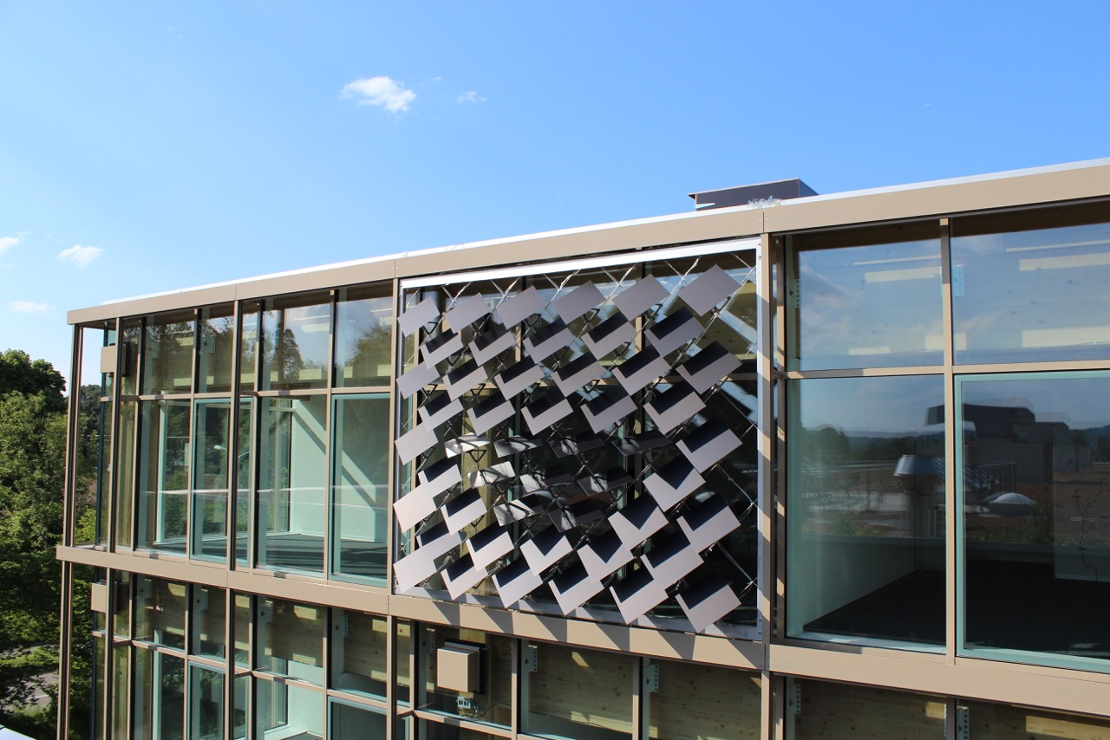
Numerical Analysis of the Adaptive Solar Façade
Jeremias Schmidli
Supervisor: Prageeth Jayathissa

Slide 2
The Adaptive Solar Façade (ASF)
Individually Actuated Panels
Combines Dynamic Shading with PV-Electricity Production
Needs to be Optimized for Cooling, Heating, Lighting, Actuation and PV-Electricity Production

Slide 3
Overview
Introduction
Problem Description
Methodology
Results and Discussion
Conclusions and Outlook

Slide 4
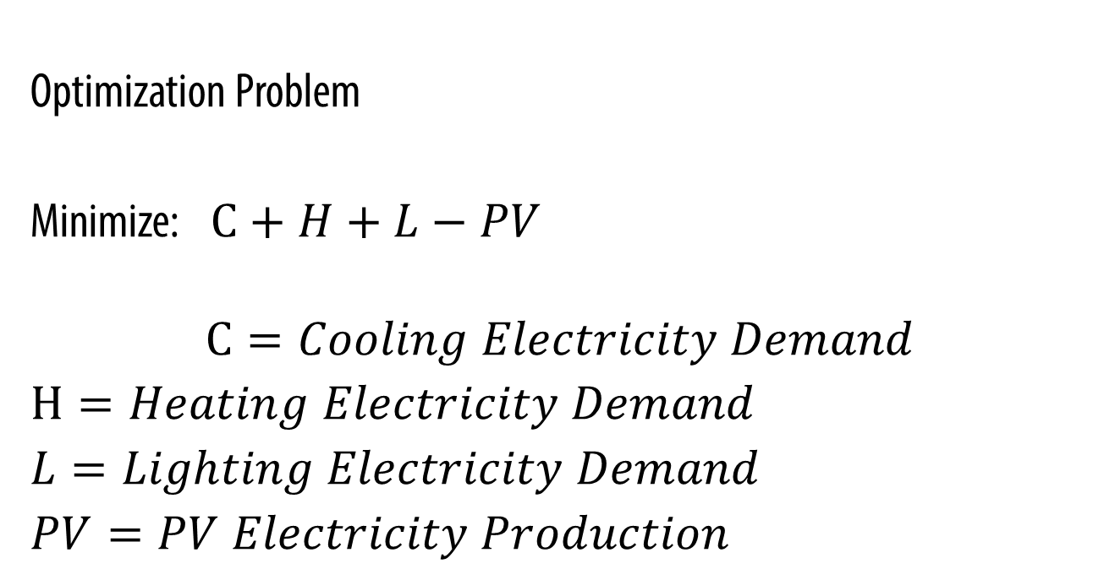
Problem Description
Optimization Problem
Minimize: $C+H+L−PV$
$$C=Cooling Electricity Demand$$
$H=Heating Electricity Demand$
$L=Lighting Electricity Demand$
$PV=PV Electricity Production$

Slide 5
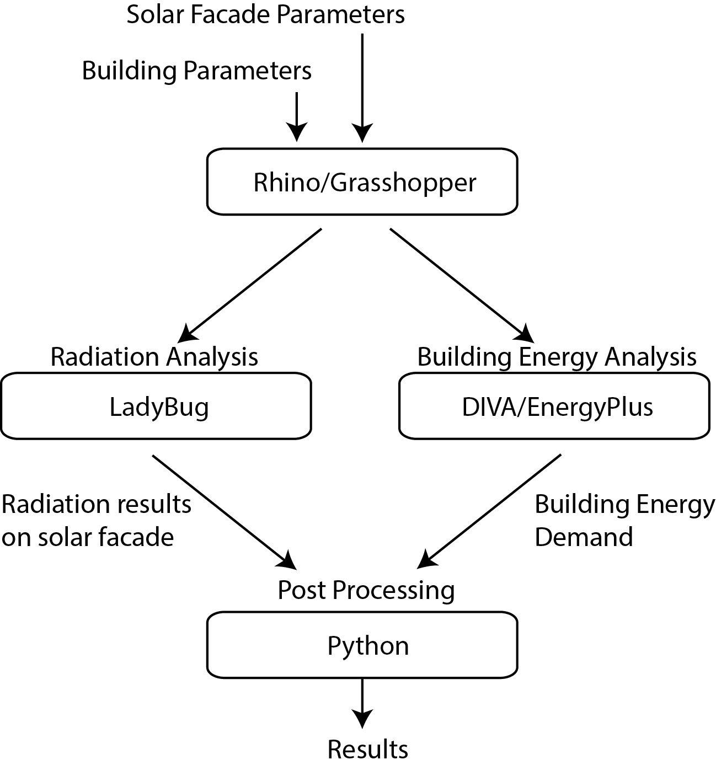
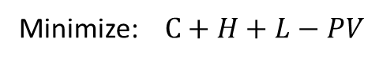
Methodology
Combination Of Different Tools To Achieve Optimal Results
Minimize: $C+H+L−PV$
Notes:
Add minimization problem

Slide 6
Case Study
Single Zone Office
Simulation for One Year
Weather File for Kloten
Notes:
Add minimization problem

Slide 7
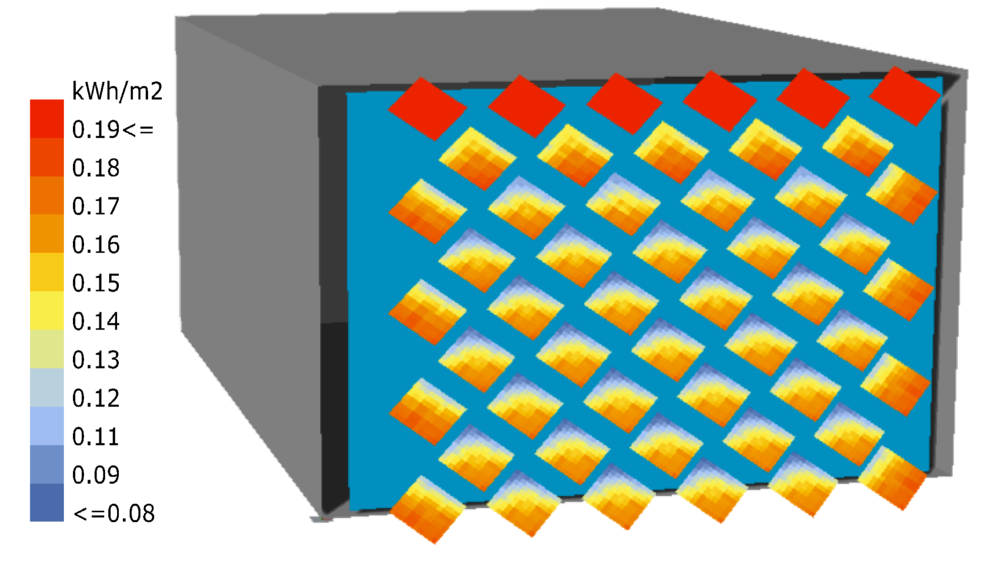
Radiation on Panels (Collaboration with Johannes)
Radiation Analysis with Ladybug
Includes Self-Shading
Insolation from 11:00-12:00 on June 16

Slide 8
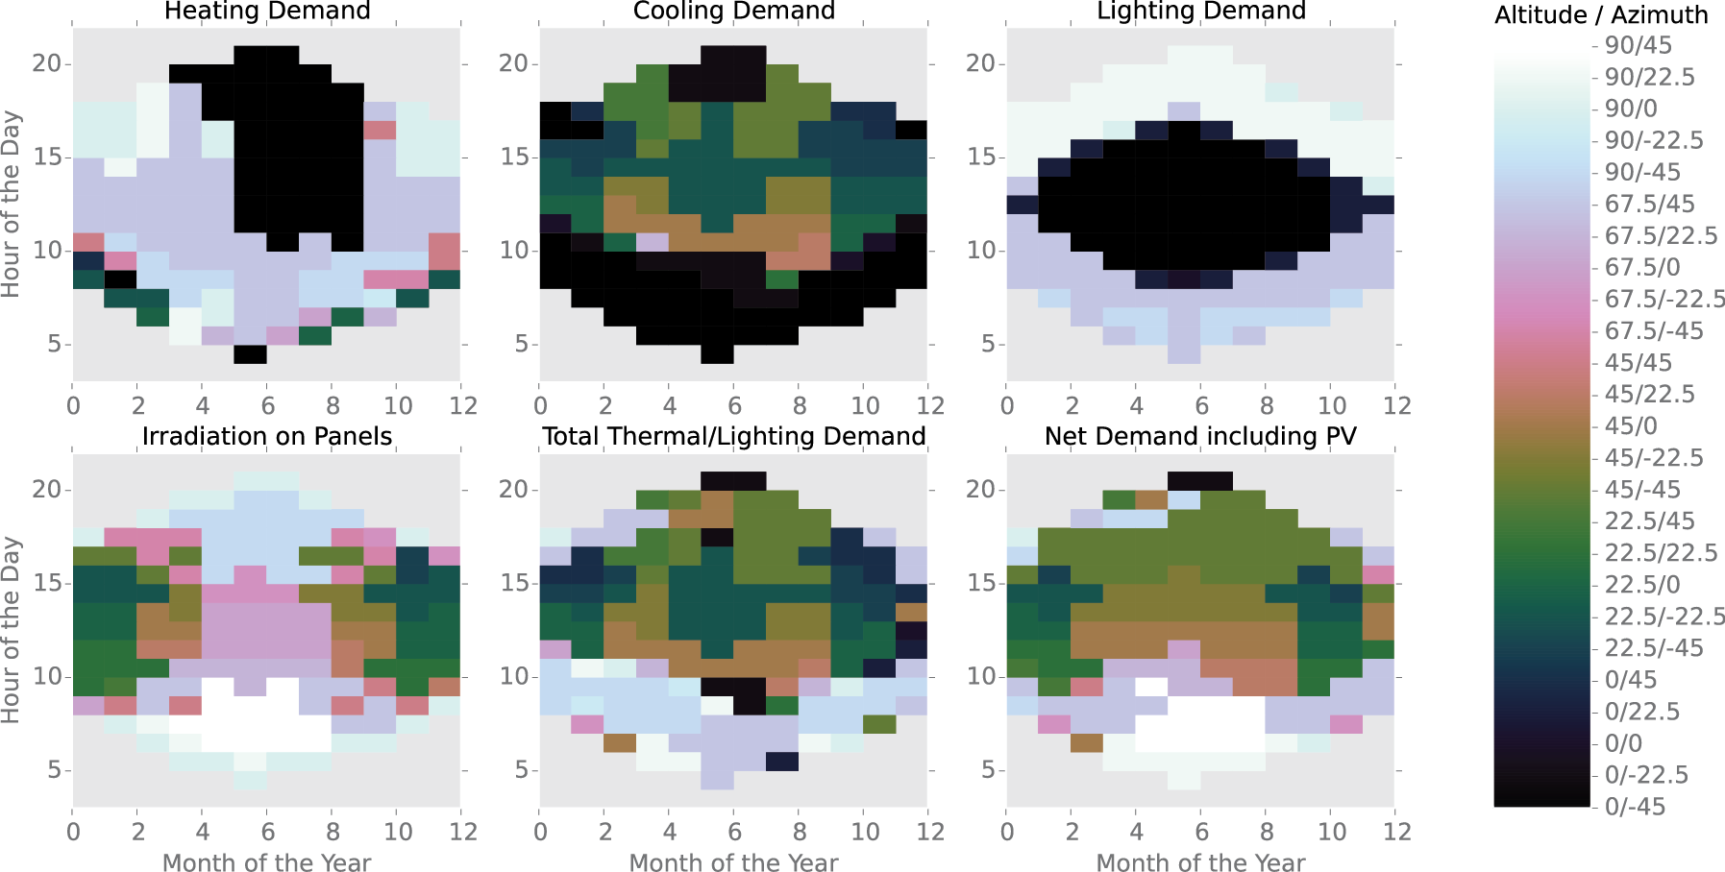
Optimum Orientation of Panels

Slide 9
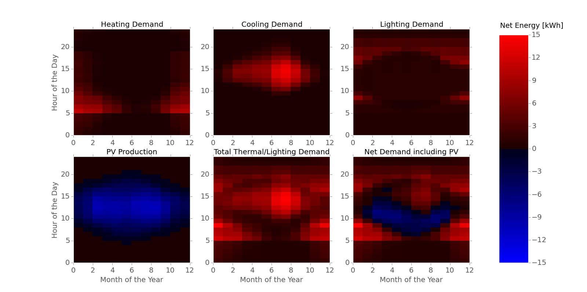
Net Energy Demand at Optimum Orientation

Slide 10
Conclusions
Developed Simulation Framework for the ASF
Successfully combine PV-Electricity Production with Building Energy Demand
Optimal Angles for Single Cluster Found

Slide 11
Outlook
Development of RC-Building Energy Simulation Tool (Collaboration with Mario and Amr)
Include detailed Efficiency Analysis of PV-Electricity Production (Collaboration with Johannes)
Include Energy-Use for Actuation in Simulation
Analyze Results for different Regions and Building Typologies
Use Multiple Clusters of PV-Panels

Slide 12
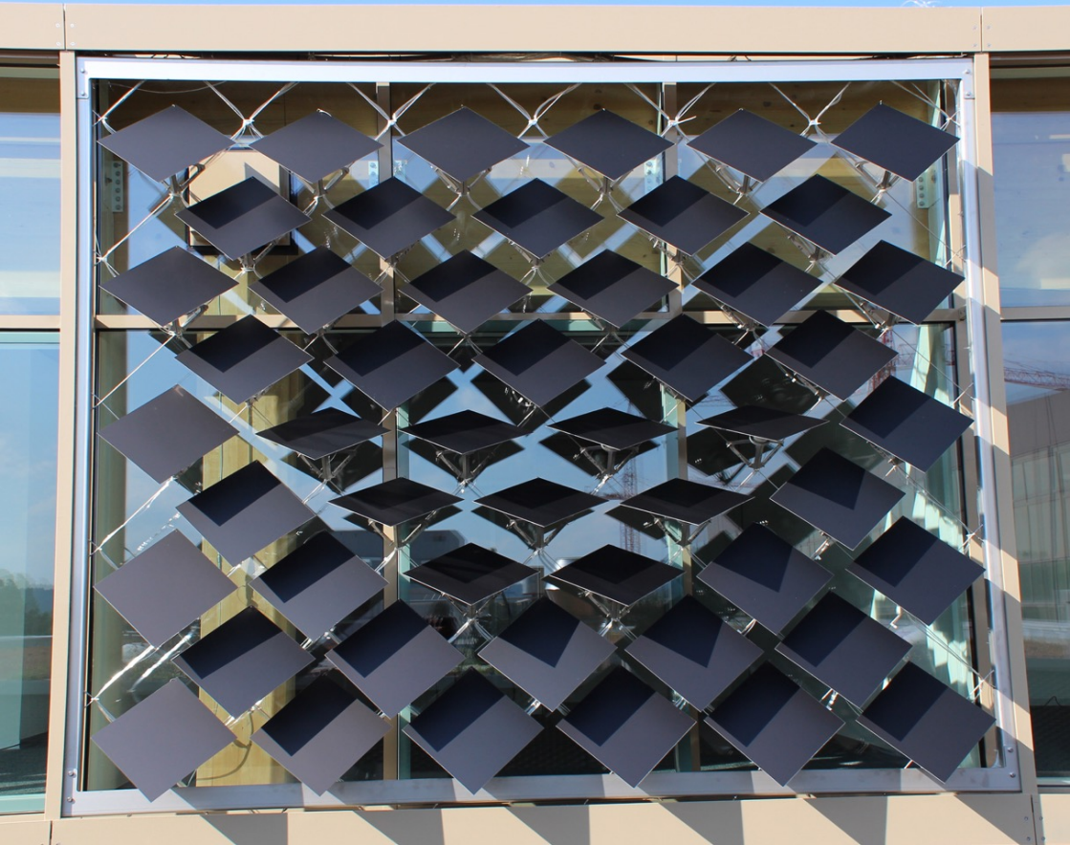
Questions?
https://github.com/architecture-building-systems/ASF_Simulation

Slide 13
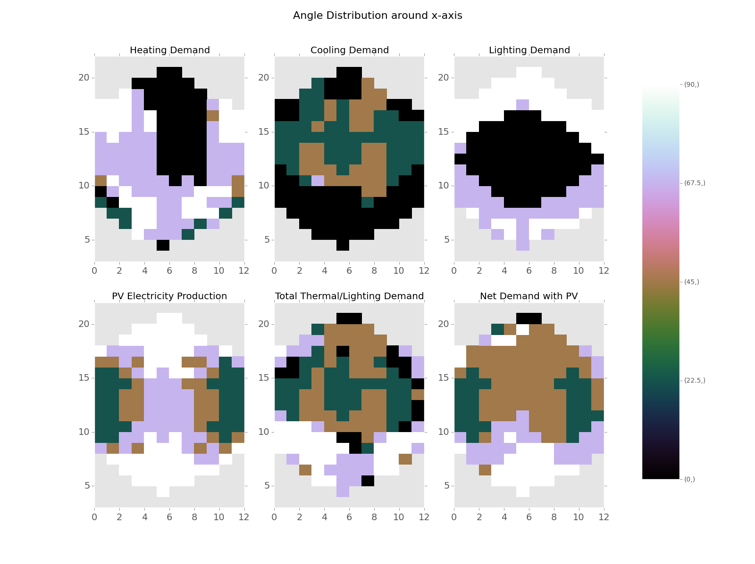
Developed Simulation Framework for the ASF
Optimum Angle Combinations Found
Possibility to Include PV-Electricity Production

Slide 14
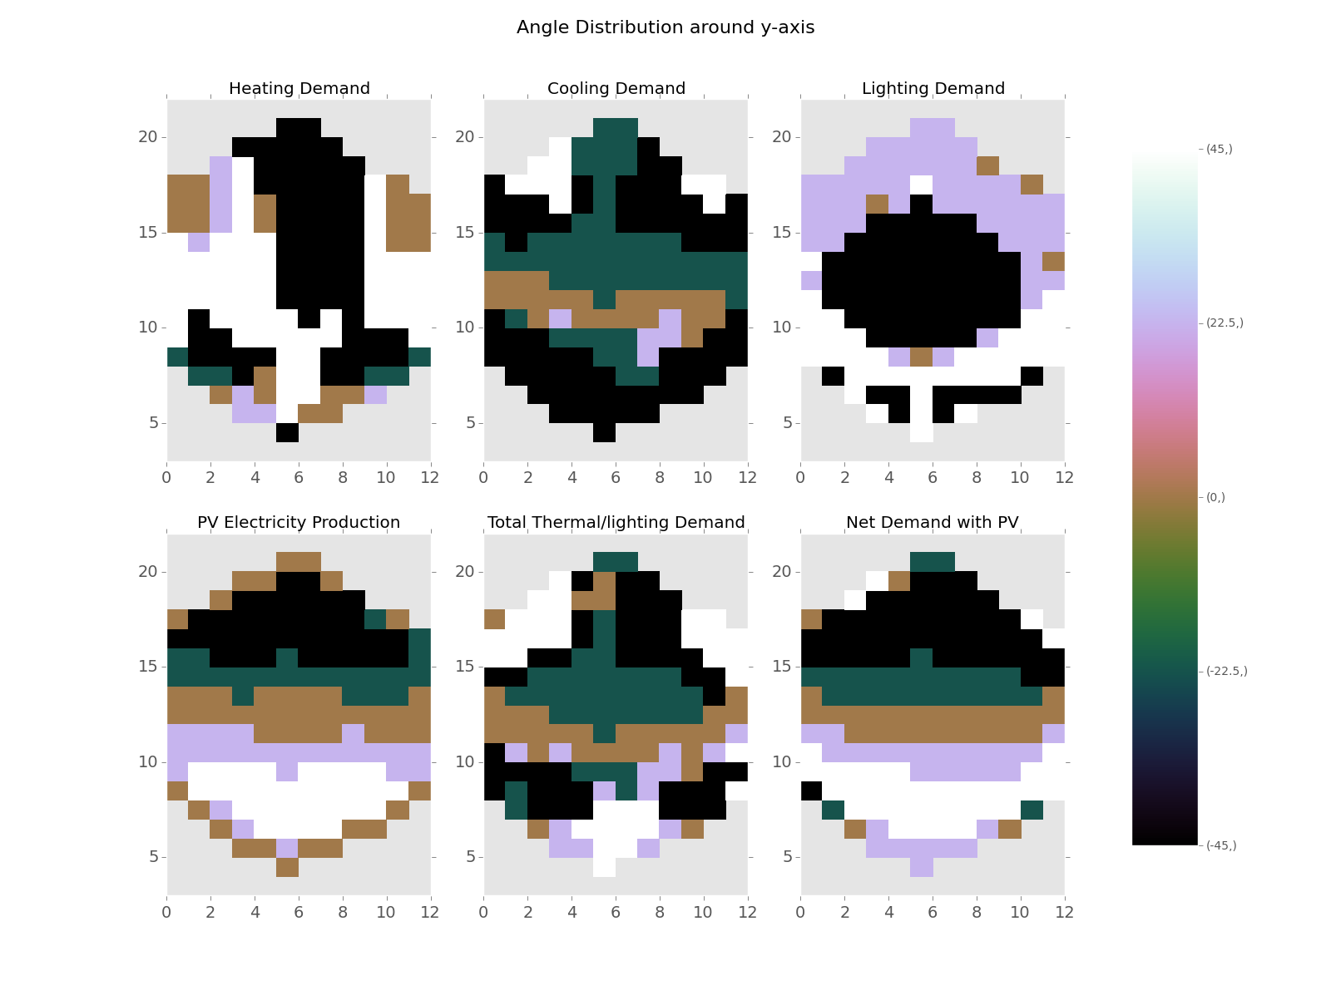
Developed Simulation Framework for the ASF
Optimum Angle Combinations Found
Possibility to Include PV-Electricity Production

Slide 16
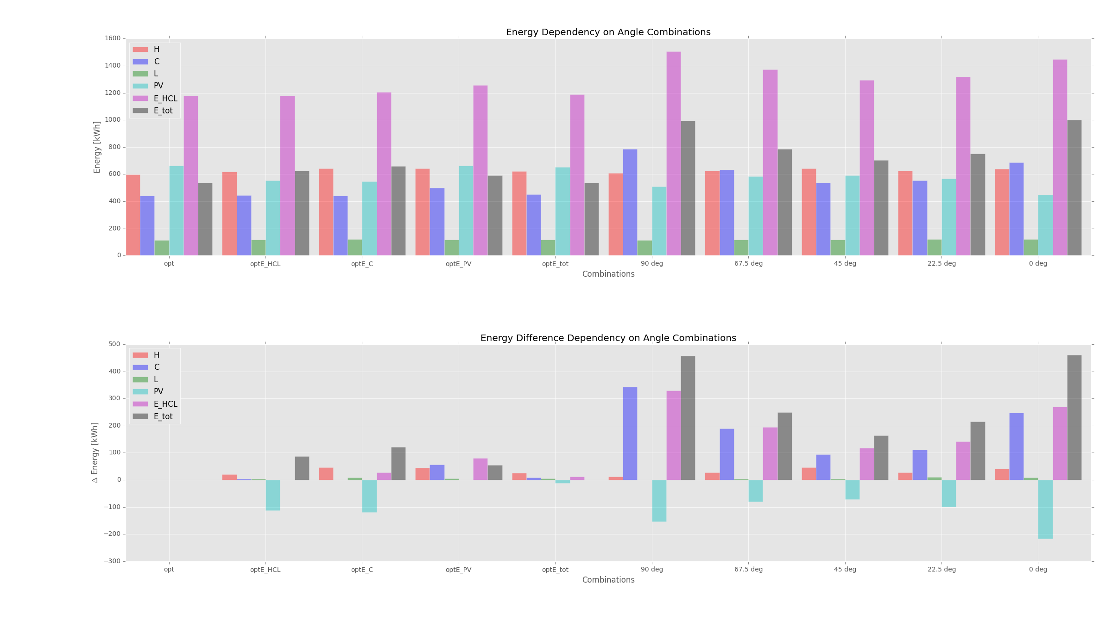
Heating COP = 3 Cooling COP = 3 Lighting = 3 W/m2 PV-efficiency = 0.072

Slide 17
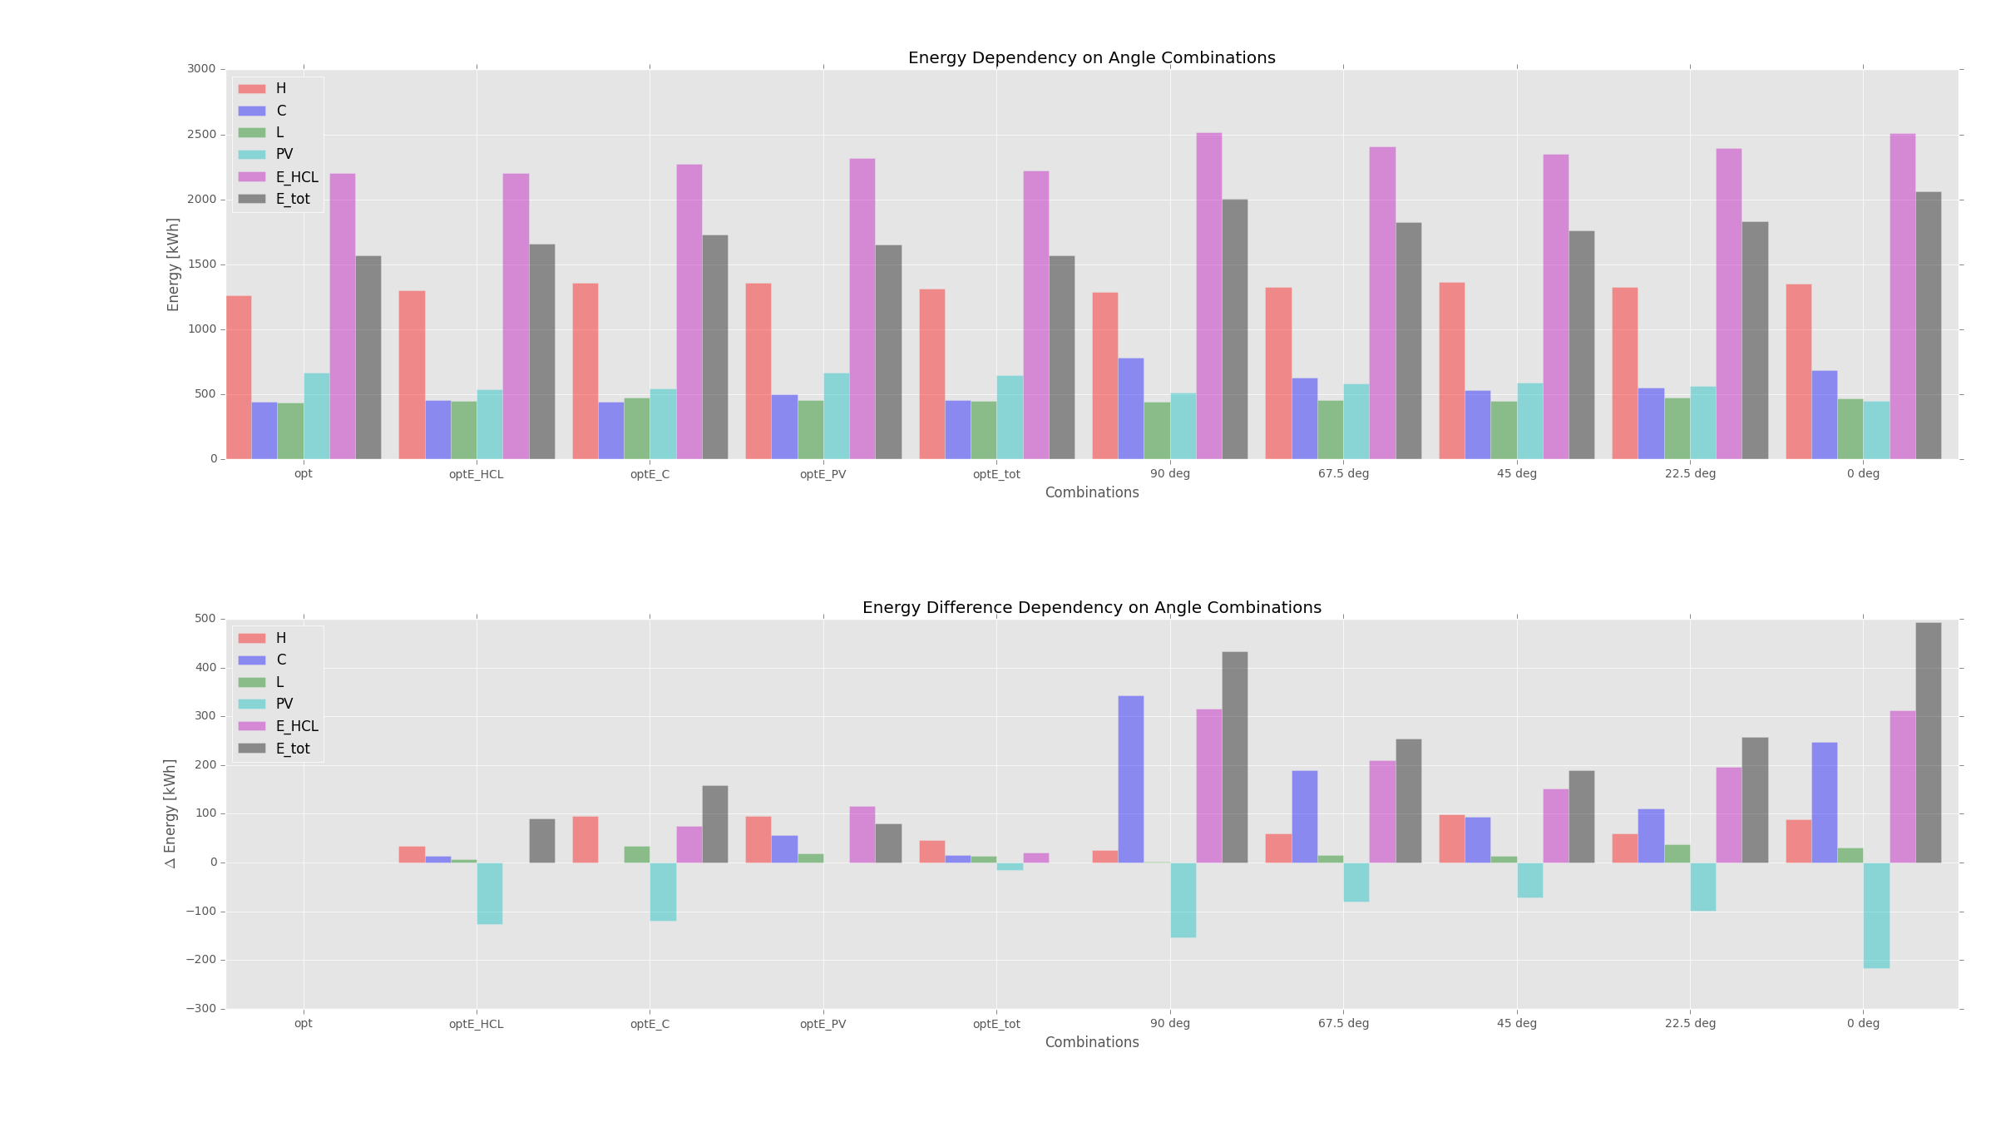
Heating COP = 0.85 Cooling COP = 3 Lighting = 11.74 W/m2 PV-efficiency = 0.072

Slide 18
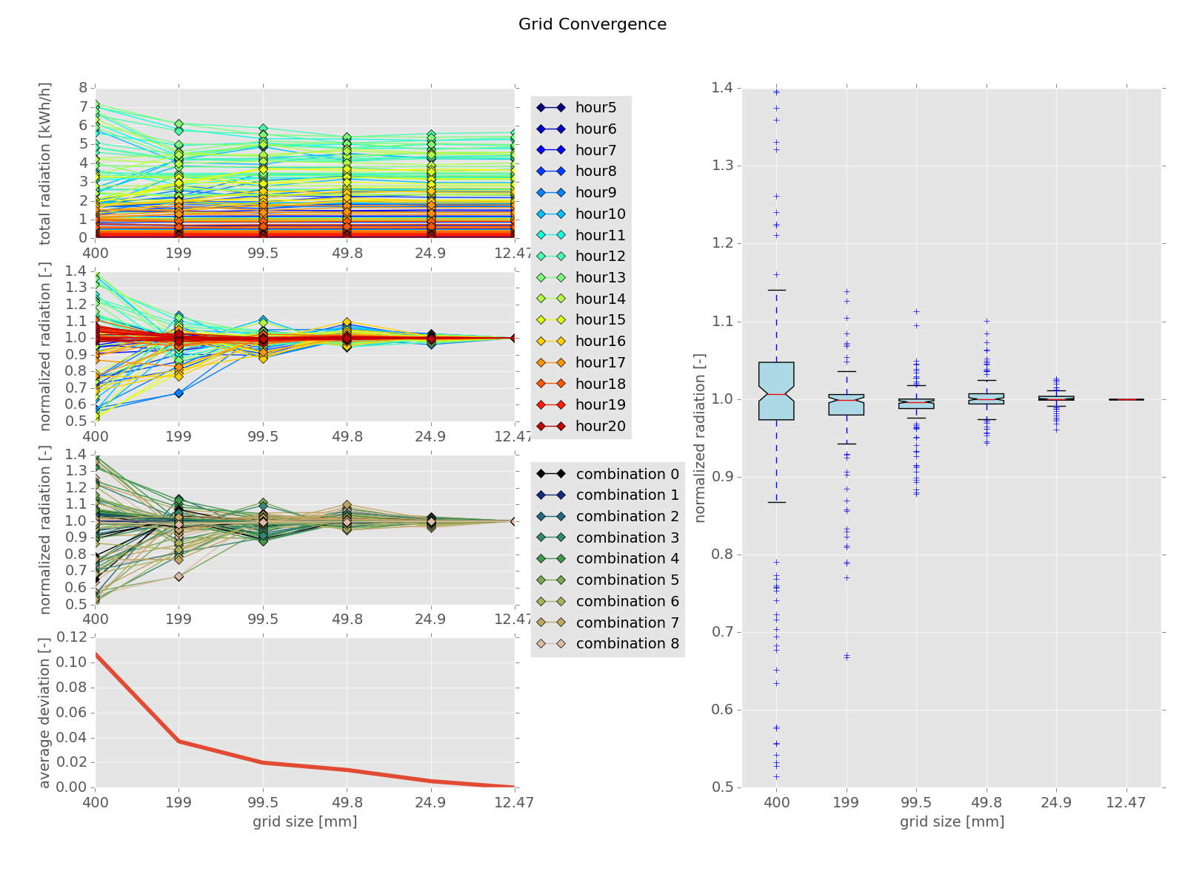
Conclusions
Developed Simulation Framework for the ASF
Optimum Angle Combinations Found
Possibility to Include PV-Electricity Production

Slide 19
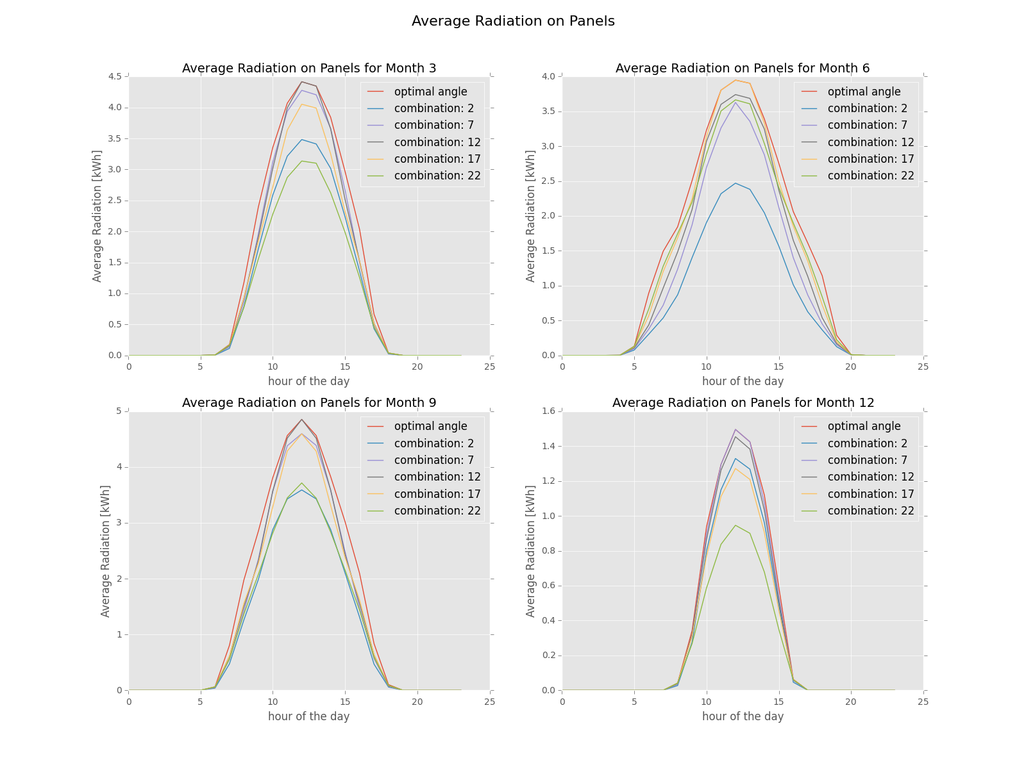
Conclusions
Developed Simulation Framework for the ASF
Optimum Angle Combinations Found
Possibility to Include PV-Electricity Production

Slide 20
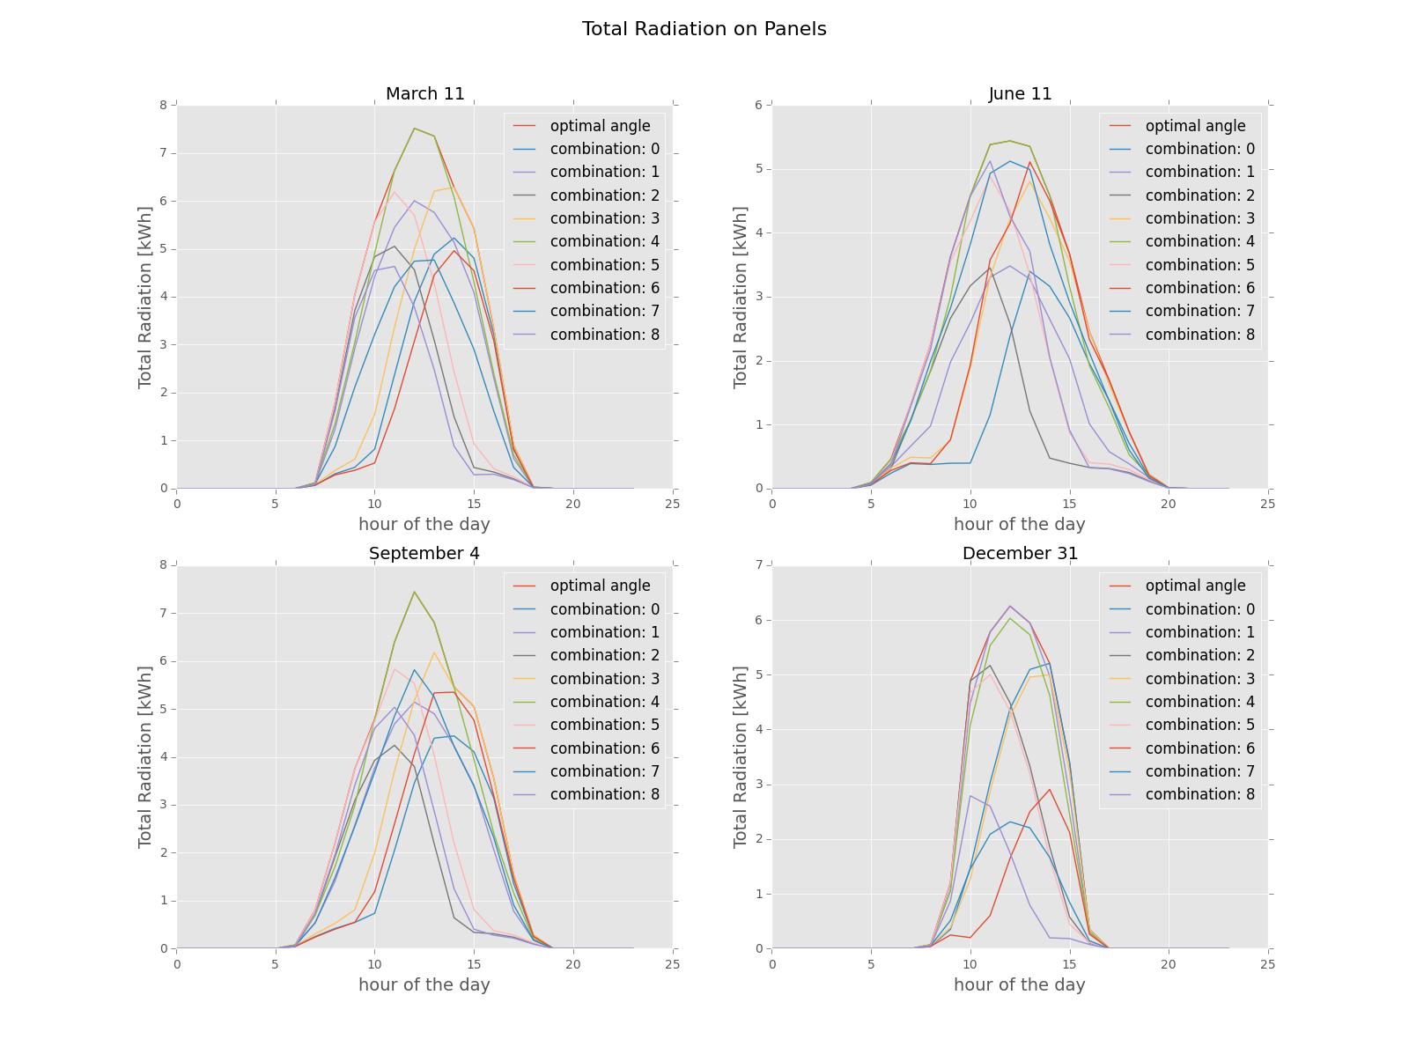
Conclusions
Developed Simulation Framework for the ASF
Optimum Angle Combinations Found
Possibility to Include PV-Electricity Production

